Slide 1

London International Showing Series
Competitor Information

Slide 2
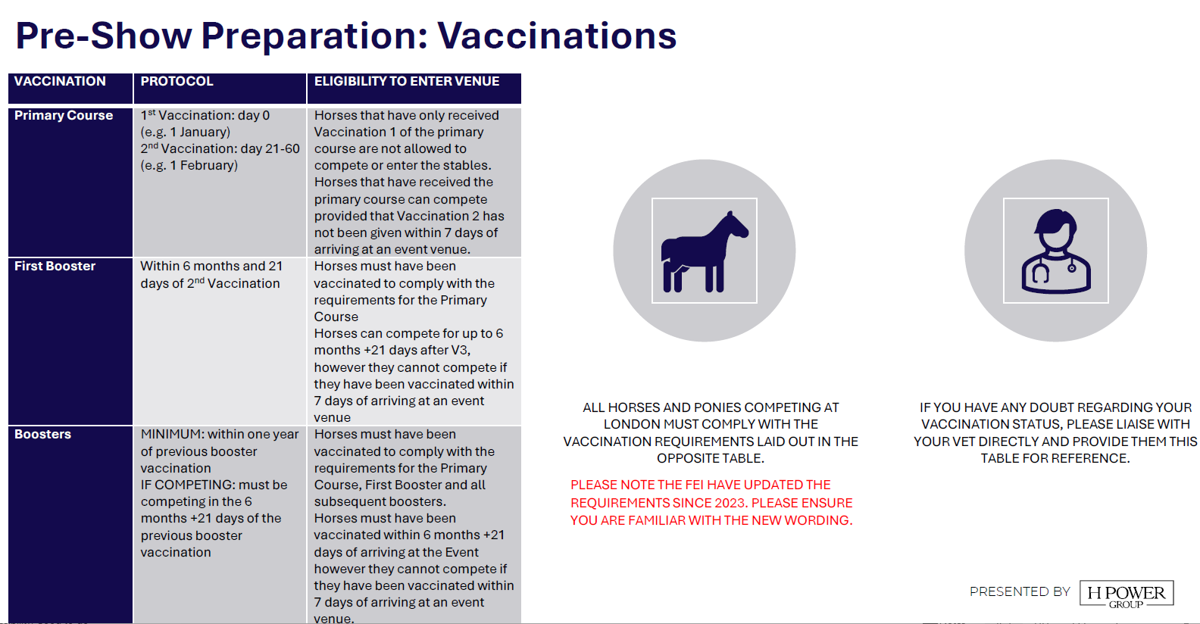

Slide 3


Slide 4


Slide 5
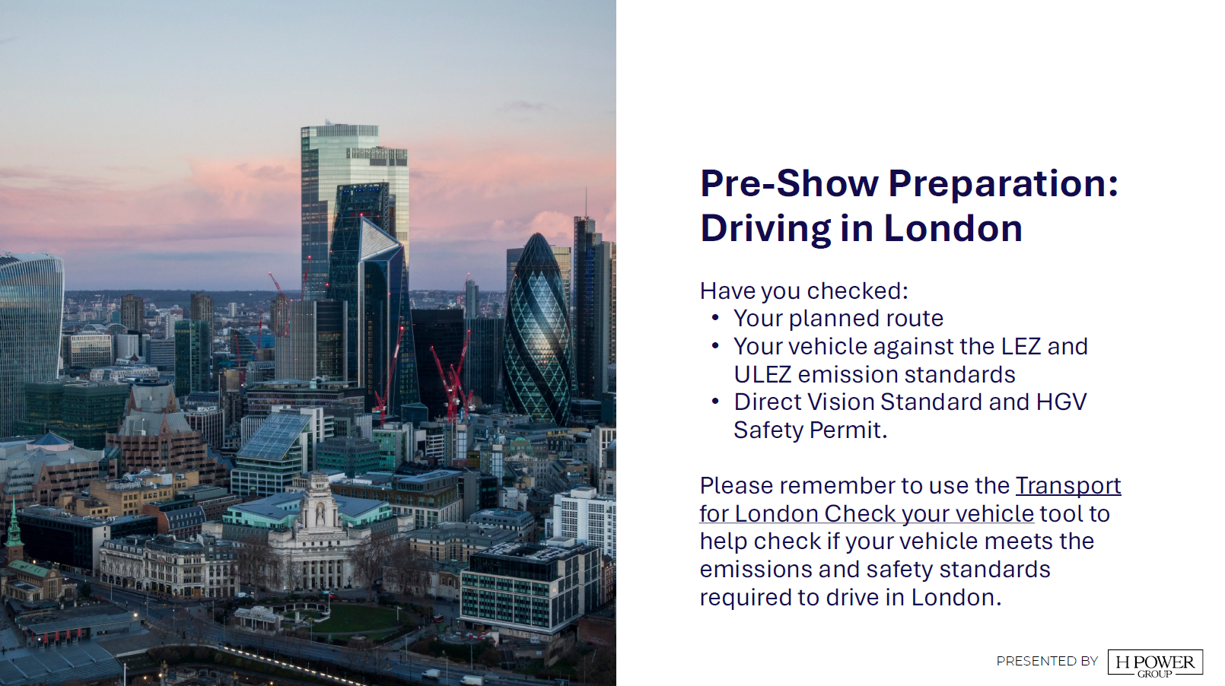

Slide 6


Slide 7


